Slide 1
SWITCH
RELAY LAB KIT

Slide 2
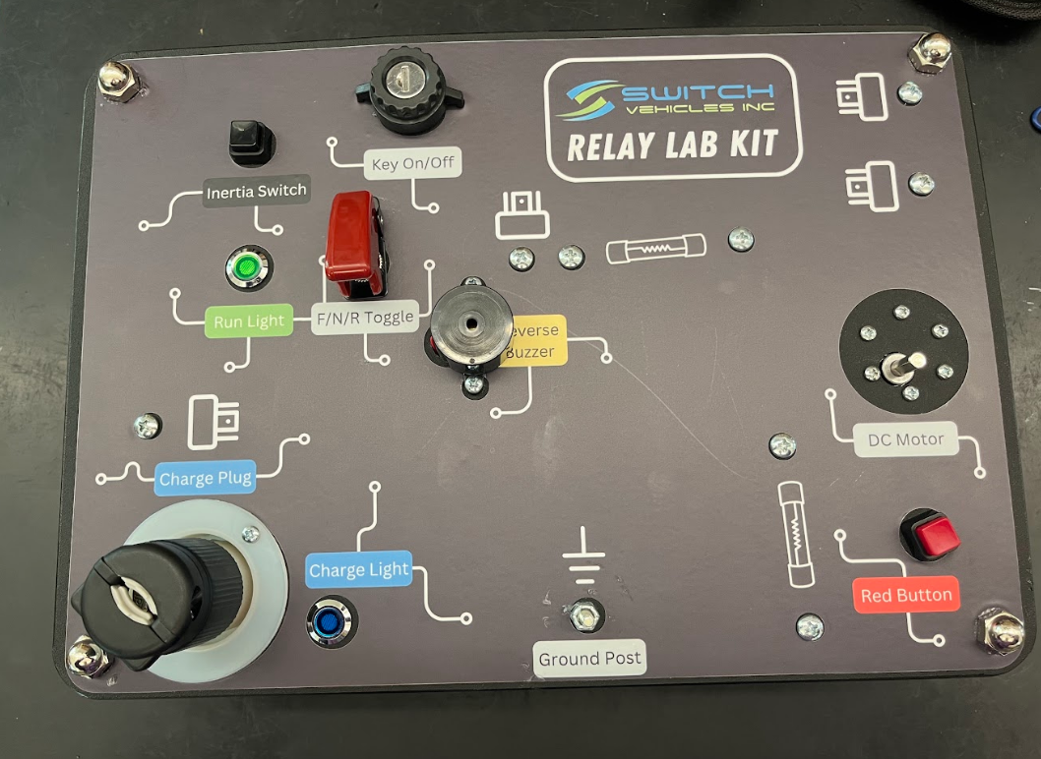
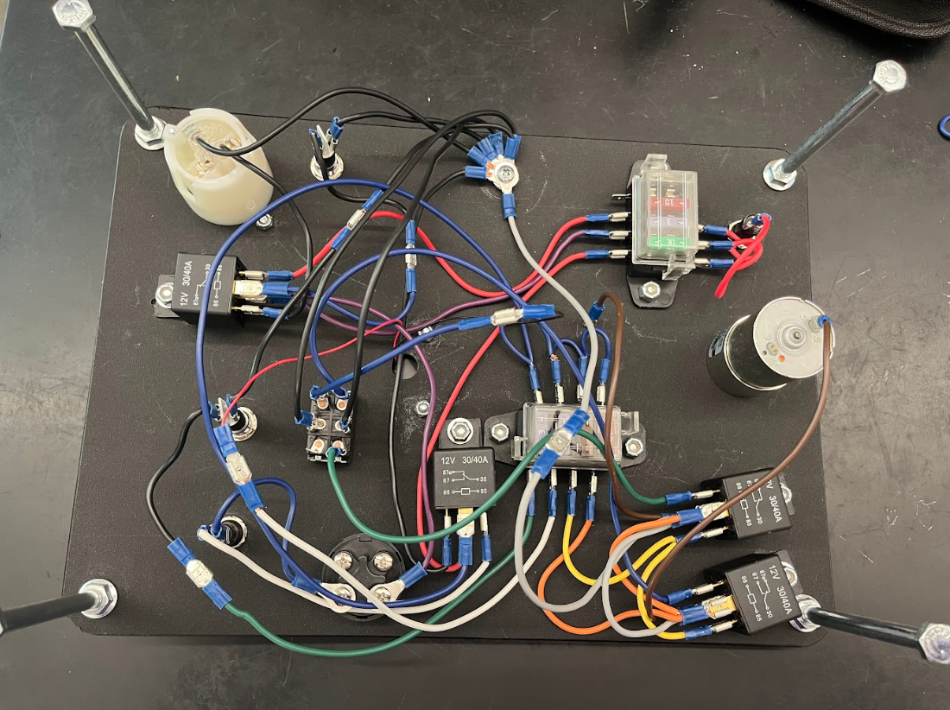
Essential Question:
How does the Switch Relay Kit work?
Objective:
Students will build the SWITCH Relay Lab Kit to understand the principles of relay circuits, identify their components, and explore their applications in systems like the Switch vehicle.
This will take multiple class periods

Slide 3
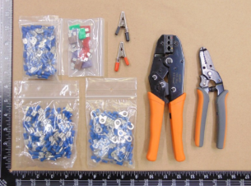
TOOLS NEEDED:
#2 Phillips Head Screwdriver
● 5/16” Wrench
● 3/8” Wrench
● 1/2” Wrench
● 9/16” Wrench
WIRE TERMINATION KIT:
1/4” Female Spade Terminations
1/4” Male Spade Terminations
1/4” Ring Terminations
Alligator Clips
Termination Cripers
Wire Strippers
Fuse Pack:
4x 3Amp, 4x 5Amp, 4x 10Amp, 2x 30Amp
WIRE TERMINATION KIT

Slide 4
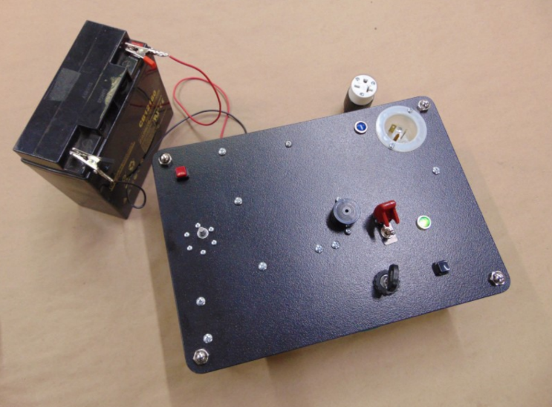
COMPONENTS:
Begin by going over the necessary parts that should be included in the SWITCH Relay Lab Kit.
Once all components are accounted for follow the step by step instructions to build your relay

Slide 5
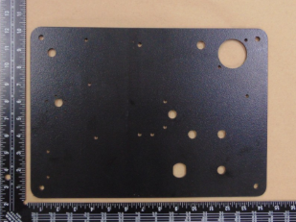
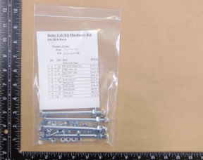
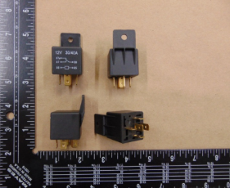
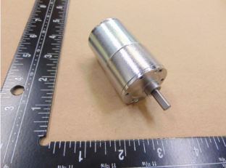
COMPONENTS LIST:
Mounting Panel (A)
  Dimensions: l4” x 10” x 3/16” Top View: Large hole is in Upper Right
Relay Lab Hardware Kit (SVI-ID: HK-RLK) (B)
4x Relays (C)
  Single Pole Double Throw
  Equivalent vehicle relays: Key, Charge, Forward, Reverse
DC Motor (D)
  Output shaft with built in gear reduction
A
B
C
D

Slide 6
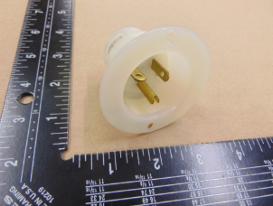
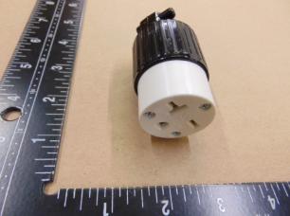
COMPONENTS LIST (CONTINUED):
Socket (E)
  Represents AC power inlet for vehicle charging
  Only use with the corresponding plug from the kit. Do not plug extension or other cords into the socket.
Plug (F)
  Represents AC line power
  Only use with the corresponding socket from the kit. Do not plug extension or other cords into the plug.
E
F

Slide 7
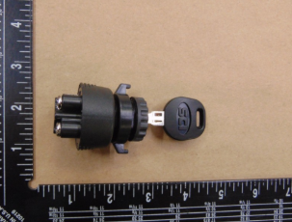
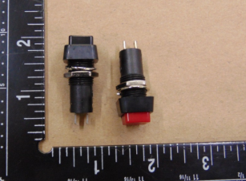
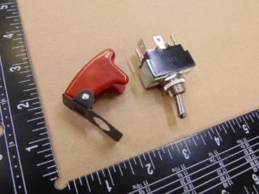
COMPONENTS LIST (CONTINUED):
Off-On-(On) Key Switch (G)
  Pin 1: Common, Pin 2: Active if Momentary is ON, Pin 3: Active if Switched On, Pin 4: Active if Switched On or Momentary is On.
On-Off Toggle Switches (H)
  Red toggle switch represents the Big Red Button Black toggle switch represents the Inertia Switch
On-Off-On Toggle Switch (I)
  Double pole double through switch Protective switch cover Represents the Forward-Neutral-Reverse switch.
G
H
I

Slide 8
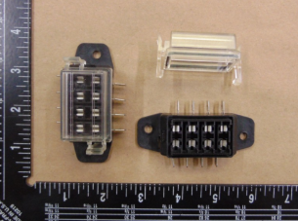
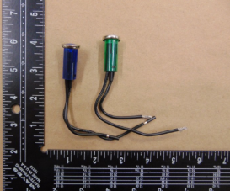
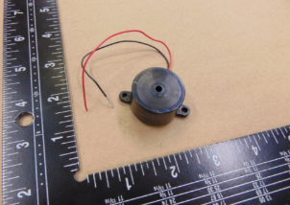
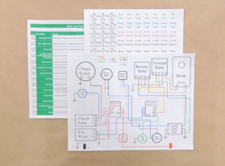
COMPONENTS LIST (CONTINUED):
2x Fuse Blocks (J)
  Clear protective cover
2x Lights (K)
  Blue Light: Represents vehicle state “Charging”. Green Light: Represents vehicle state “Drive Ready”
Buzzer (L)
  Represents reverse buzzer in vehicle
Documentation (M)
  Wiring Diagram, Component Labels, Component Action Sheet
J
K
L
M

Slide 9
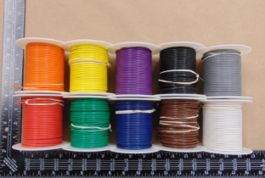
COMPONENTS LIST (CONTINUED):
Wire Spools (O)
  One 100 foot spool of each color:
  Red, Orange, Yellow, Green, Blue, Purple, Brown, Black, Gray, White
Spools are included in the Relay Lab Kit Pro version.
O

Slide 10
LET’S GET STARTED

Slide 11
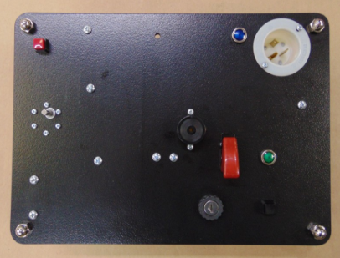
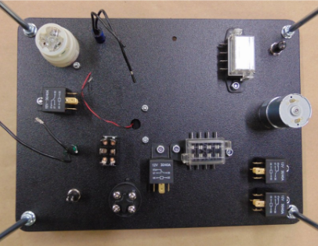
ASSEMBLY:
The switches
and toggles, lights, buzzer and socket are all accessible from the top of the panel. The relays,
fuse blocks, and wiring is all done underneath the panel. To the right is the top and bottom view of
the panel after all parts have been mounted.
This is only one of many ways to build it. Most
parts can be placed on either side of the panel, and in multiple locations. The order of
installation is also a suggestion, and the parts may be installed in any order.
TOP
BOTTOM

Slide 12
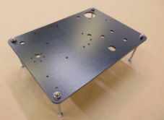
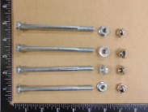
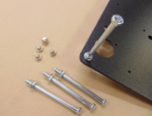
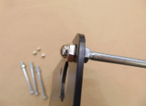
PANEL SUPPORTS:
Begin, by bolting the support legs onto the panel, this will make it easier to work on throughout the project. Each leg uses a 5/16”-18 x 4-1/2” bolt
First, thread the flange nut to the bottom of the threads
Next place the bolt in the corner hole,
Last, Screw the cap nut all way down, then adjust the flange nut location to tighten the bolt to the board. Making sure the board is level and even (no wobbles)
FINAL PRODUCT
FLANGE
NUT
BOLT
END OF STEP 3
CAP NUT

Slide 13
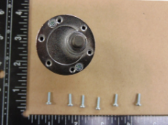
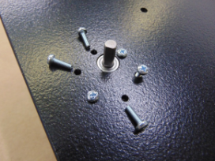
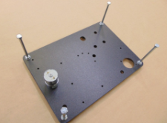
THE MOTOR:
The motor is mounted underneath the board with the output shaft pointing upwards. It uses six M3 x 10mm screws to hold it in place.
Insert the screws from the bottom of the board
←

Slide 14
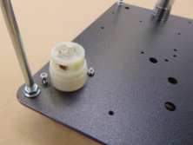
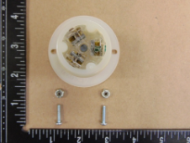
CHARGE SOCKET:
With the panel face up, the charge socket is mounted in the upper right corner.
It is installed using two #6 x 3/4” machine screws with nylon insert lock nuts.
The socket represents the
power receptacle use to charge the vehicle with an extension cord.

Slide 15
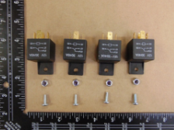
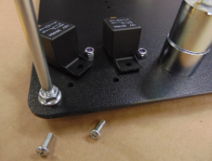
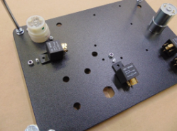
RELAYS:
There are four single pole double throw relays. Each relay uses a #10-24 x 1/2” machine screw with nylon insert locknut to secure it to the bottom of the panel.
Two relays are mounted near the motor.
These will be the forward and reverse relays,
representing the Forward-Reverse Contactor in the vehicle.
One relay is mounted near the charge socket,
representing the charge relay.
The final relay is mounted near the center of
the panel, and represents the key relay.

Slide 16

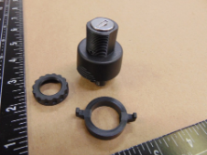
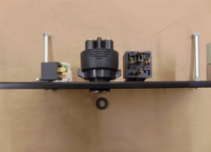
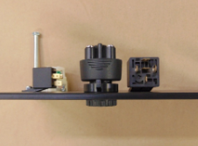
KEY SWITCH:
The key switch includes a key, the switch body, a locking nut for underneath the panel, and a top nut for above the panel.
The key switch fits snuggly into the oblong hole near the middle relay.
The locking nut has two flat sides that match the flat sides on the key switch. This helps the nut slide easily along the switch until it touches the panel. First, move the locking nut all the way back toward the key switch. Then push the key switch through the hole and screw on the top nut until it’s tight. Finally, adjust the bottom nut to keep the switch firmly in place.

Slide 17
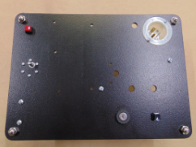
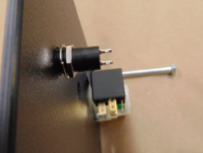
PUSH BUTTON TOGGLE SWITCH:
The red toggle switch represents the Big Red Button in the vehicle, and effectively disconnects all 12 volt power supplies to the Always On Fuse Block.
It is mounted in the upper left corner of the panel above the motor using the 1/2” nut and lock washer included with the switch.
The black toggle switch represents the Inertia Switch in the vehicle. When triggered, the coil power for the key relay is disconnected, effectively turning off the vehicle. It is mounted to the right of the key switch with a 1/2” nut and lock washer.

Slide 18
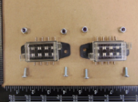
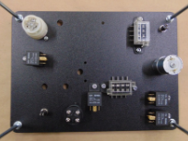
FUSE BLOCKS:
The two fuse blocks are mounted underneath the
panel, each using two #10-24 x 1/2” machine screws with a nylon insert locknut.
One fuse block is mounted near the center relay and key switch, this is the Key On Fuse Block. When the key is switched on, the key relay activates and allows power to supply this fuse block from the Always On Fuse Block.
The second fuse block is the Always On Fuse block, and is mounted near the red toggle switch on the motor side of the panel. The 12 volt battery provides the supply to this fuse block, with only the Red Toggle Switch(Big Red Button) in line between the fuse block and the battery.

Slide 19
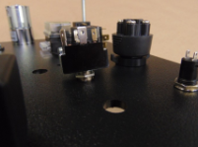
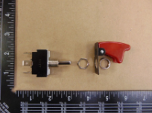
ON/OFF TOGGLE SWITCH & COVER:
This On-Off-On switch is a double pole double throw switch, representing the Forward-Neutral- Reverse(FNR) switch in the vehicle.
The switch is mounted with a nut underneath the panel, as well as one above the cover. The cover has tab that aligns with a notch on the switch for correct orientation. The switch is mounted near the key switch.

Slide 20
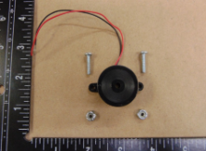
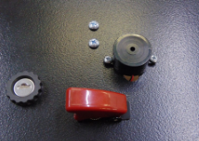
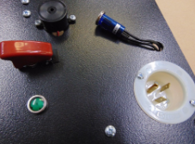
BUZZER:
The buzzer is installed on the top of the panel, with the lead wires going through the 1/2” relief hole. It uses two #6 x 3/4” machine screws with nylon insert locknuts. The buzzer represents the reverse buzzer on the vehicle, and turns on when the vehicle is put into reverse via the Forward-Neutral-Reverse Switch.
BLUE & GREEN LIGHTS:
The blue light is pressed into the 1/2” hole next to the charge socket. It represents the charge light in the vehicle, activating when the charging circuit is active. The green light is pressed into the 1/2” hole next to the Forward-Neutral-Reverse Switch. It represents the ready light in the vehicle, activating when the key is switched on and the vehicle is ready to drive.

Slide 21
NEEDED SKILLS TO CONTINUE

Slide 22
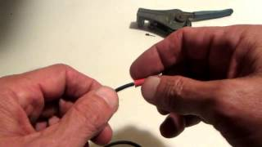
SKILLS:
The following slides contain skills needed in order to complete the wiring of the SWITCH relay
Crimping: Crimping is when you squeeze a metal connector tightly onto the end of a wire so it stays attached. It makes sure electricity can flow safely and the wire won’t come loose.
Termination: Termination means connecting the end of a wire to something, like a connector, so it can be used in a circuit. It’s how the wire is "finished" and ready to be attached to equipment.
Nylon Termination Shroud: This is a small cover, usually made of nylon (a strong plastic), that goes over the place where the wire connects to something. It protects the connection and keeps it safe from dirt, damage, or touching other wires.
Wire Insulation: Wire insulation is the plastic or rubber coating around a wire. It protects people from getting shocked and keeps the electricity inside the wire from jumping to other things.

Slide 23
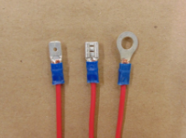
WIRING TERMINATIONS:
For this lab, the focus is on simple, effective crimping.
The process involves cutting a wire to the proper length, stripping the insulation (exterior) off the wire, and making a secure connection to a termination by crimping the termination around the wire.
The picture to the shows examples of good crimps. The copper wire protrudes minimally from the nylon(blue) termination shroud, the wire insulation ends inside the shroud, and the termination itself is not deformed in any way.
GOOD CRIMPS

Slide 24
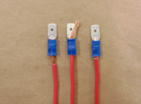
WIRING TERMINATIONS:
The picture shows examples of bad crimps.
WIRE 1: The insulation ends well before the shroud, leaving exposed wire.
WIRE 2: The copper wire exceeds the shroud(blue) to the extent it would interfere with the connection, also leaving exposed wire.
WIRE 3: The example shows the copper wire being split when inserted into the termination, with some strands folding backwards and sticking out of the shroud on the insulation side. This exposes wire behind the termination as well as effectively reducing wire gauge as not all strands are able to carry current through the connection.
BAD CRIMPS
#1 #2 #3

Slide 25
HOW TO STRIP A WIRE: (The next slide has an example.)
Cutting Wires:
Some crimpers and pliers have a spot for cutting wires. In your lab kit, the cutting blade is on the wire stripper tool.
Using the Stripping Tool:
The stripper looks like a mix of scissors and pliers. It has holes labeled with wire sizes (called gauges). Your kit uses 16-gauge wire.
Stripping Steps:
– Put the wire into the hole marked “16.”
– Squeeze the tool all the way closed.
– Hold the tool closed and pull the wire out.
– The plastic coating (insulation) will come off, leaving bare wire.
How Much to Strip:
The amount of insulation you remove depends on the connector (termination) you're using.

Slide 26
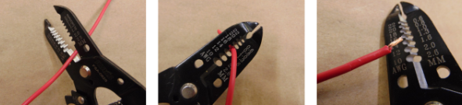
WIRING STRIPPING EXAMPLE:

Slide 27
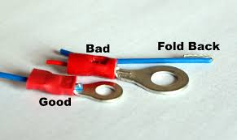
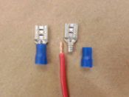
CRIMPING:
Effective crimping is essential to secure connections. A poorly made crimp can lead to numerous headaches down the road if something is not working as it should, or more commonly, only working intermittently or randomly.
COMMON CRIMPING MISTAKES:
Not crimped enough. Vibrations over time and accidental pulling of wires will physically remove the wire from the termination, breaking contact.
Crimping some but not all of the strands. This will limit the current that can safely travel through the termination.
Excessive stripping of wires. Exposed wire strands before or after the termination are vulnerable to short circuiting. Any conductive element can short the exposed wire.

Slide 28
HOW TO CRIMP A WIRE: (Review the youtube video on slide 22 if needed)
Strip the Wire:
Take off about 1/4 inch of the plastic coating (insulation) from the end of the wire. This matches the size of most connectors in the kit. If you're not sure how much to strip, remove the plastic cover (shroud) from the connector and match it up.
Choose the Right Connector:
Connectors come in different sizes. Pick one that matches the thickness (gauge) of your wire. Tools usually have labels or colors to help you pick the right size.
Crimp It:
Put the connector in the tool first, then push the wire in and squeeze the tool tightly. If the connector falls off, try a smaller size. If it cuts the wire, try a bigger size.
Tool Tips:
Some tools crimp in one spot, and others crimp both the connector and the shroud. Tools may look the same but work slightly differently.

Slide 29






CRIMPING (EXAMPLE):

Slide 30
CUTTING THE WIRE TO LENGTH:
Why Length Matters: If a wire is too long, it’s harder to follow, can get damaged, and might cause problems with how electricity flows. If it’s too short, it can pull loose or break over time. Wires that are too long or too short also get in the way when you're working.
Best Wire Length: Make the wire as short as possible, but still long enough to reach and allow for some movement (like from vibrations when driving). Wires shouldn’t be tight or pulling at the ends when connected.
How to Measure: An easy way to get the right length is to:
  Connect one end where it belongs
  Route the wire along the path you want
  Cut the wire where it ends
If you're not using a spool, start with a longer piece and trim it after routing.
Wire Routing Tips: Sometimes wires need to go around corners or in groups. Try to keep them neat and organized. Messy, tangled wires are hard to fix if something goes wrong.

Slide 31






CUTTING THE WIRE TO LENGTH (EXAMPLE):

Slide 32
LET’S GET WIRING!

Slide 33

LABELING & WIRING THE PANEL:
Start by Labeling: It helps to label the relays and fuse blocks first.
  The Charge Relay is on the far left.
  The Key Relay is in the lower center.
  The Forward Relay is the top right one.
  The Reverse Relay is below the Forward Relay.
  The Always On Fuse Block is the vertical one at the top.
  The Key On Fuse Block is the horizontal one near the Key Relay.
You can label the other parts now or later.

Slide 34
LABELING & WIRING THE PANEL:
Wiring Order:
There’s no one right way to wire the panel. The steps shown here follow a path that makes it easier to find each part as you go. You can change the wire paths and lengths as needed.
Adjusting for Your Setup:
If your parts are in different places than shown, just follow the wiring diagram to know where each wire goes.

Slide 37
TOP
BOTTOM

Slide 38

RED PUSH BUTTON TOGGLE SWITCH:
The Red Toggle Switch gets power straight from the battery.
It sends power to the Always On Fuse Block.
What You’ll Need:
One 5-inch red wire
Two 3-inch red wires
Important Tip:
To chain wires together, put both wires into the same connector before you crimp it. This lets the power flow to more than one place.

Slide 39

WIRING THE ALWAYS ON FUSE BLOCK:
The Always On Fuse Block gets power from the Red Toggle Switch.
It sends power to the Charge Relay and the Key Relay.
Wires to Add:
8-inch purple wire → from the fuse block to Charge Relay pin 30
8-inch red wire → from the fuse block to Charge Relay pin 85
14-inch red wire → from the fuse block to Key Relay pin 30

Slide 40



WIRING THE CHARGE RELAY:
The Charge Relay gets power from the Always On Fuse Block. It controls power going to the Key Relay and the Blue Light, depending on whether the system is charging.
Connecting the Blue Light:
Use a male-female connector. Connect the charging socket, insert a stripped wire into the hole and tighten the screw to hold it in place.
Wires to Add:
8-inch purple wire: from Pin 87a on the relay to Key Switch Post #1
7-inch black wire: from Pin 86 on the relay to the Charge Socket
4-inch blue wire: from Pin 87 on the relay to the Blue Light
MALE FEMALE CONNECTOR

Slide 41




CHARGE SOCKET AND PLUG:
In this lab, we’re pretending to plug in a vehicle — but we're NOT using real wall power
The Charge Socket has 3 spots for wires.
The green screw is for ground (this keeps things safe).The other two screws connect to the other pins in the socket..
One wire from the socket goes to ground.
Another wire goes to the coil on the Charge Relay.
Inside the Charge Plug, all 3 pins are connected together with short wires.
When you plug the plug into the socket, it completes the circuit, and the Charge Relay turns on.
⚠️ Safety Reminder: This setup is for practice only. Never use real AC (wall) power with it!
Wires to Add:
9-inch black wire → from socket to Ground Post
Two 3-inch wires → to connect all 3 pins inside the plug

Slide 42

SETTING UP COMMON GROUND:
The common ground is where all the ground wires connect. It's on the edge of the panel, between the Blue Light and the Always On Fuse Block.
NEEDED: 1 screw, 2 washers, 1 locknut (won’t come loose easily). The screw goes down through the top of the panel.
Underneath: Put 1 washer. Then add ground wire rings as needed. Add the second washer and the nut to hold everything together
Tip: Just use your fingers to tighten the nut first. You’ll be adding more of ground wires here. Once they’re all on, tighten it fully.
You’ll Add 7 Ground Wires in Total In this order (from the manual):
9" black – from Charge Socket
4" black – from Blue Light
12" black – from Key Relay (Pin 86)
3" black – from Green Light
8" gray – from Forward & Reverse Relay (Pins 87a)
9" black – from On-Off-On Toggle Switch (Pins 2 & 5)
24" black – from Battery Clip

Slide 43


BLUE LIGHT:
The Blue Light turns on when the Charge Relay is activated during charging. It has two wires (called leads). Either wire can be the ground or the positive power. If a wire is too short, you can connect it to a male-female connector to make it longer.
New wire to add: 4-inch black wire to the Ground Post (this is the usual length).
KEY RELAY:
The Key Relay controls power to the Key On Fuse Block.
It is turned on by the Key Switch and gets power from the Always On Fuse Block.
New wires to add:
12-inch black wire from Pin 86 to the Ground Post
8-inch white wire from Pin 85 to the Black Push Button Toggle Switch
13-inch blue wire from Pin 87 to the Key On Fuse Block, linked with three short 3-inch wires

Slide 44


BLACK PUSH BUTTON TOGGLE SWITCH:
This switch sends power to the Key Relay coil when you turn it on. It gets power from the Key Switch.
New wire to add: 4-inch blue wire to Key Switch Post 4
GREEN LIGHT:
The Green Light turns on when the Key On Fuse Block has power. It is connected between the Black Toggle Switch, On-Off-On Toggle Switch, and the Charge Relay.
New wires to add:
3-inch black wire from the Green Light to the Ground Post
9-inch green wire from the Green Light to the Key On Fuse Block

Slide 45

LET’S CHECK OUR WORK:
NOT ALL THE WIRES ON THE RIGHT HAVE BEEN ADDED BUT CHECK YOUR PROGRESS SO FAR

Slide 46

KEY ON THE FUSE BLOCK:
The Key On Fuse Block is the main power supply that turns on when switched. It gets power from the Always On Fuse Block through the Key Relay. The Key Switch must be turned on, and the Black Toggle Switch must be set before the Key Relay can turn on and power the fuse block. The Key On Fuse Block powers the Green Light, Reverse Buzzer, Motor, and the Forward and Reverse Relays.
Wires to Add (from the fuse block):
4-inch yellow wire (plus a chained 4-inch piece) to Pin 85 on both the Forward Relay and Reverse Relay
4-inch orange wire (plus a chained 4-inch piece) to Pin 87 on both the Forward Relay and Reverse Relay
7-inch white wire to the Red Buzzer

Slide 47

BUZZER WIRE(S):
The buzzer wires are very thin and easy to break, so be careful not to pull them apart.
To connect thin wires with a big connector, strip 2x-3x more insulation than usual. Then fold the wire back on itself to make it thicker for crimping.
New wire to add:
4-inch black wire from the Buzzer lead to Pin 6 on the On-Off-On Toggle Switch

Slide 48

FORWARD AND REVERSE RELAYS:
The coils (Pin 85) of both relays are connected together and get power from the Key On Fuse Block. The normally open pins (Pin 87) of both relays are connected and powered from the same fuse block.The normally closed pins (Pin 87a) of both relays are connected together and go to the Ground Post. The common pin (Pin 30) on each relay connects to the motor’s terminals.
When a relay is turned on, power flows through that relay to the motor. The power then comes back through the other relay, which is off, and goes to ground. This switches the motor’s direction depending on which relay is active.
New wires to add:
8-inch gray wire plus a chained 4-inch piece from Pin 87a on both relays to the Ground Post
10-inch green wire from Pin 86 on the Forward Relay to Pin 1 on the On-Off-On Toggle Switch
10-inch blue wire from Pin 86 on the Reverse Relay to Pin 3 on the On-Off-On Toggle Switch

Slide 49

THE MOTOR WIRING:
The motor has two wires: one for positive and one for negative.
Sometimes, depending on how the motor is made, it might spin the wrong way (forward when it should go backward, or the other way around).
Easy fix: Just swap the two motor wires to change the direction.
Wires to Add:
10-inch brown wire from Forward Relay Pin 87 to the positive side of the motor
10-inch brown wire from Reverse Relay Pin 87 to the negative side of the motor

Slide 50

ON/OFF/ON TOGGLE SWITCH:
This switch controls which way the motor spins by turning on either the Forward or Reverse Relay. When you flip the switch, it connects to ground, which activates the relay and controls the motor’s direction.
Wire to Add:
9-inch black wire with a chained 4-inch piece from Pins 2 & 5 on the toggle switch to the Ground Post

Slide 51

BATTERY LEADS:
Now that the panel is wired, the last step is to connect the battery for power. You can use the vehicle's auxiliary battery, or any 12-volt battery.The positive side of the battery goes to the Red Toggle Switch. The negative side of the battery goes to the Ground Post.
How to Connect the Battery:
Use the alligator clips to make wires long enough to reach the battery.
Crimping the clips can be tricky:
  Crimp once. Then turn the connector 90 degrees and crimp again.
  If the wire feels too thin, fold it over before crimping to make the connection tighter.
Once the black wire is added to the Ground Post, tighten the nut fully so everything is secure.
New Wires to Add:
24-inch red wire from Battery Positive to the Red Toggle Switch
24-inch black wire from Battery Negative to the Ground Post

Slide 52
LET’S CHECK OUR WORK:
NOT ALL THE WIRES ON THE RIGHT HAVE BEEN ADDED BUT CHECK YOUR PROGRESS SO FAR

Slide 53
YOU NOW SHOULD HAVE A COMPLETED PANEL
CHECK YOU WORK AND COMPARE TO THIS EXAMPLE

Slide 54


Slide 55
TESTING THE PANEL

Slide 56

FINAL CHECK BEFORE TESTING:
Before turning anything on, double-check all your wires:
Make sure nothing is loose or missing.
Use the wiring diagram to check for correct connections.
Make sure no metal parts (terminations) are touching each other — that could cause a short circuit.
Add the Fuses and Connect Power
Fuses help protect the electronics if something goes wrong. They are placed close to the battery, so they can stop any problems fast.
🔋 Always On Fuse Block (works all the time):
10 amp fuse – for the charge relay coil
3 amp fuse – for the key relay coil and blue light
30 amp fuse – for sending power to the Key On Fuse Block

Slide 57

MORE ON FUSES:
Key On Fuse Block (only works when key is ON):
3 amp fuse – for the buzzer
5 amp fuse – for direction relays
3 amp fuse – for the green light
10 amp fuse – for the motor
In real vehicles, the motor uses a much bigger fuse (250–400 amps) because it runs off high voltage.
🛠 Fuses Help You Troubleshoot
If something doesn’t turn on, check the fuse first.
  If the fuse is blown, the problem is after the fuse.
  If the fuse is fine, the problem is before the fuse.

Slide 58

CONNECTING THE BATTERY:
Clip the red wire (from the Red Toggle Switch) to the positive side of the 12V battery.
Clip the black wire (from the Ground Post) to the negative side.
Now you're ready to test your panel safely!

Slide 59

TESTING THE CIRCUIT:
Now that the fuses are in, the key is off, and the battery is connected:
Plug the charge plug into the charge socket.
If everything is wired correctly:
  You should hear a click (that’s the charge relay turning on).
  The blue light should also turn on.
If the Blue Light Doesn’t Turn On:
First, check the red toggle switch (big red button) — make sure it's ON so power can get to the Always On Fuse Block.
Still nothing? Check the fuses next.
If fuses are OK, the problem is probably in the wiring. Check for:
  Loose wires
  Missing wires
  Wires in the wrong place
Take your time and trace each wire carefully!

Slide 60


TESTING THE KEY CIRCUIT:
Once the blue light is on and the charge plug is still in:
Turn the key ON. Nothing should happen. This is a safety feature — it prevents the vehicle from moving while it's still charging.
Turn the key OFF and remove the charge plug from the socket.
Now Test the Motor:
Make sure the On-Off-On switch is in the center (neutral) position.
Turn the key ON. You should hear a click (the key relay). The green light should turn on.
If nothing happens, Make sure the black toggle switch (inertia switch) is turned ON.
Test Motor Directions:
With the green light on: Flip the On-Off-On switch down (Forward). The motor should start spinning forward.
Flip the switch up (Reverse). The motor should spin backward, and the buzzer should sound.

Slide 61


MOTOR TROUBLESHOOTING:
Check the black toggle switch
Check all fuses
Check your wiring
FURTHER TESTING:
Experiment with different toggle switch settings to see how they affect motor operation.
Try inserting the plug with the motor running, or pulling it out with key still in to see what happens.
If a second lab kit is available, try connecting the alligator clips to a second motor instead of the battery and rotate the shaft to power the panel.

Slide 62
YOU DID IT!
You completed the Switch Relay Lab Kit!

